Slide 1
CiberVault
Cybersecurity Awareness & Training, Built for Your Organization
cibervault.com

Slide 2
THE CHALLENGE
Your Biggest Security Risk Isn't Your Firewall
It's the inbox. Across the industry, the majority of breaches still trace back to a person — a click, a reused password, a plausible-looking request — not a defeated technical control. Firewalls and endpoint tools do not train anyone to recognize the next attack.
People, not malware
Phishing leads the way
Training changes outcomes
Most breaches begin with a human decision — a phishing click, a weak password, a rushed approval.
Email remains the most common way attackers get an initial foothold, across companies of every size.
Employees who complete regular, realistic awareness training make measurably fewer risky decisions.
CiberVault
2

Slide 3
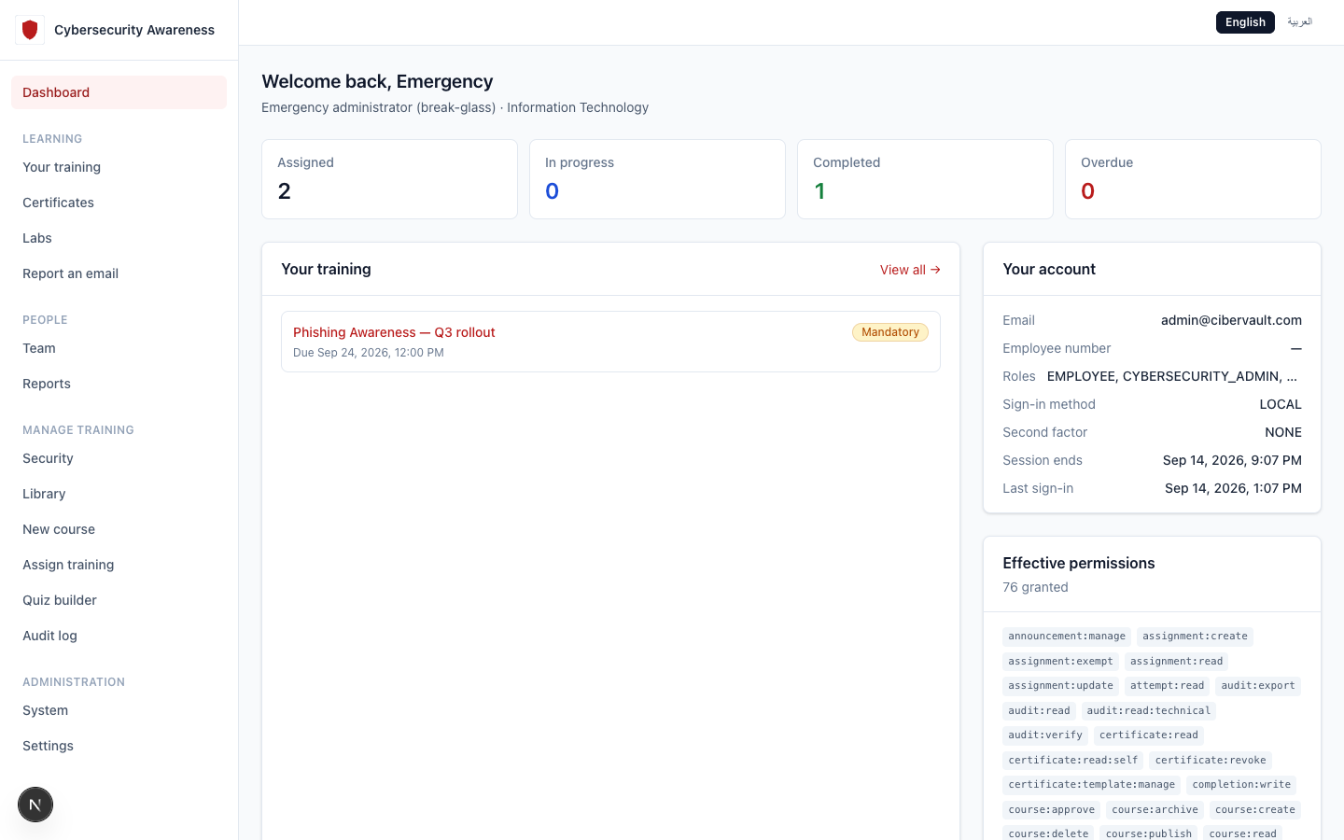
THE PLATFORM
Introducing CiberVault
A complete cybersecurity awareness platform — training, testing, certification, and
reporting, in one place your team already knows how to use.
CiberVault
3

Slide 4
WHAT'S INSIDE
Everything You Need, In One Platform
Bilingual Training
Quizzes & Assessments
Verifiable Certificates
Structured courses in English and Arabic, built around real workplace scenarios — not generic slides.
Auto-graded assessments with configurable pass thresholds, so completion means comprehension.
Every completion issues a certificate with a QR code anyone can check — no account required.
Compliance Reporting
White-Label Branding
AI-Assisted Authoring
Live completion and overdue tracking by department, so nothing waits for a spreadsheet.
Your logo, your organization name, on the login page, the header, and every certificate.
Draft quizzes and video scripts in minutes — an author always reviews before anything publishes.
CiberVault
4

Slide 5
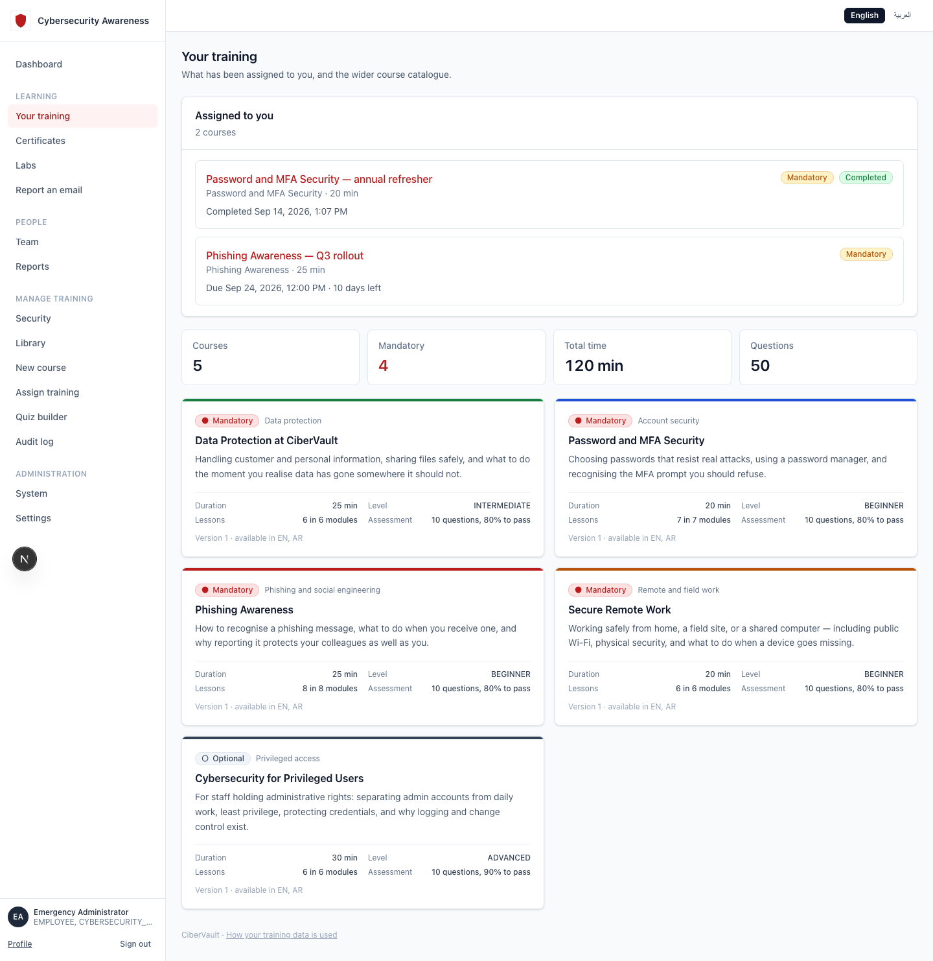
EMPLOYEE EXPERIENCE
Training Your Employees Will Actually Finish
Bite-sized by design 20–30 minutes per course, built to fit inside a real workday.
Mandatory vs. optional Clear labeling, so priority is never ambiguous.
Bilingual throughout Every course, lesson, and quiz ships in English and Arabic.
Deadline-aware Employees see exactly what's due and when, on their own dashboard.
CiberVault
5

Slide 6
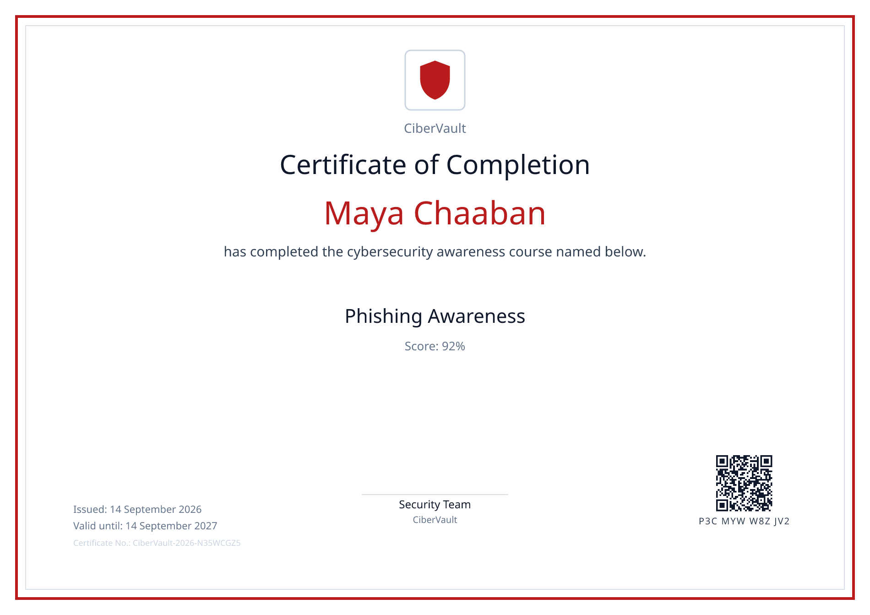
PROOF OF COMPLETION
Certificates Anyone Can Verify
Issued automatically The moment a course is completed — no manual paperwork.
Carries your branding Your organization's logo and name, not a third-party vendor's.
Publicly verifiable A QR code and code link to a public page confirming authenticity — nothing else about the employee.
Tracked expiry Certificates carry a validity window, so refreshers are never missed.
CiberVault
6

Slide 7
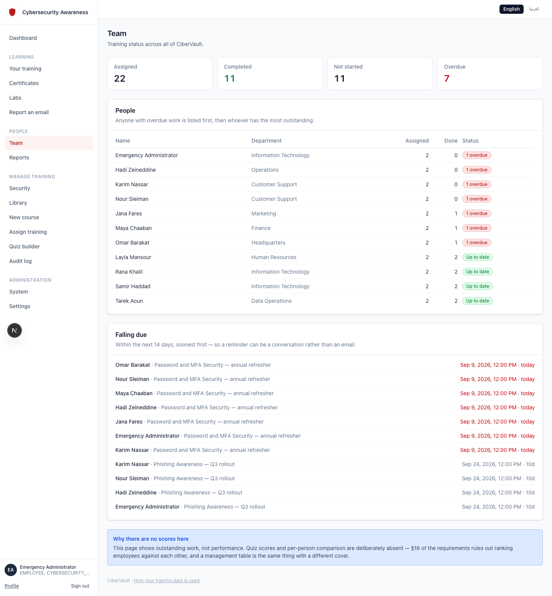
FOR MANAGERS
Give Managers the Visibility They Need
Every manager sees exactly who on their team needs a nudge — automatically, without asking IT.
CiberVault
7

Slide 8
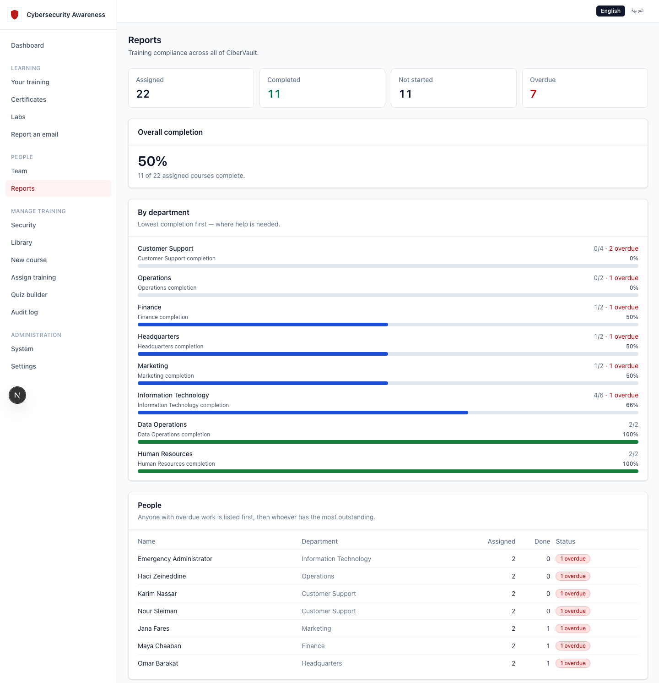
FOR SECURITY TEAMS
Organization-Wide Compliance, At a Glance
Completion rate, department breakdown, and who's overdue — the numbers a security team is asked for.
CiberVault
8

Slide 9
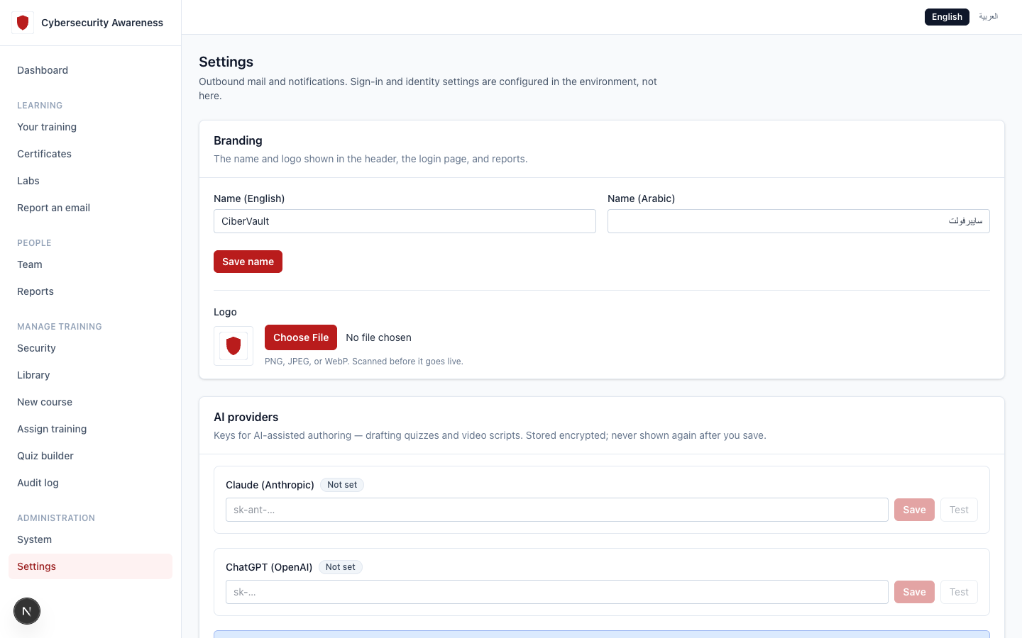
FULLY YOURS
White-Label — Your Brand, Not Ours
Set your organization's name and logo once. It appears on the login page, the header, reports, and every certificate.
CiberVault
9

Slide 10
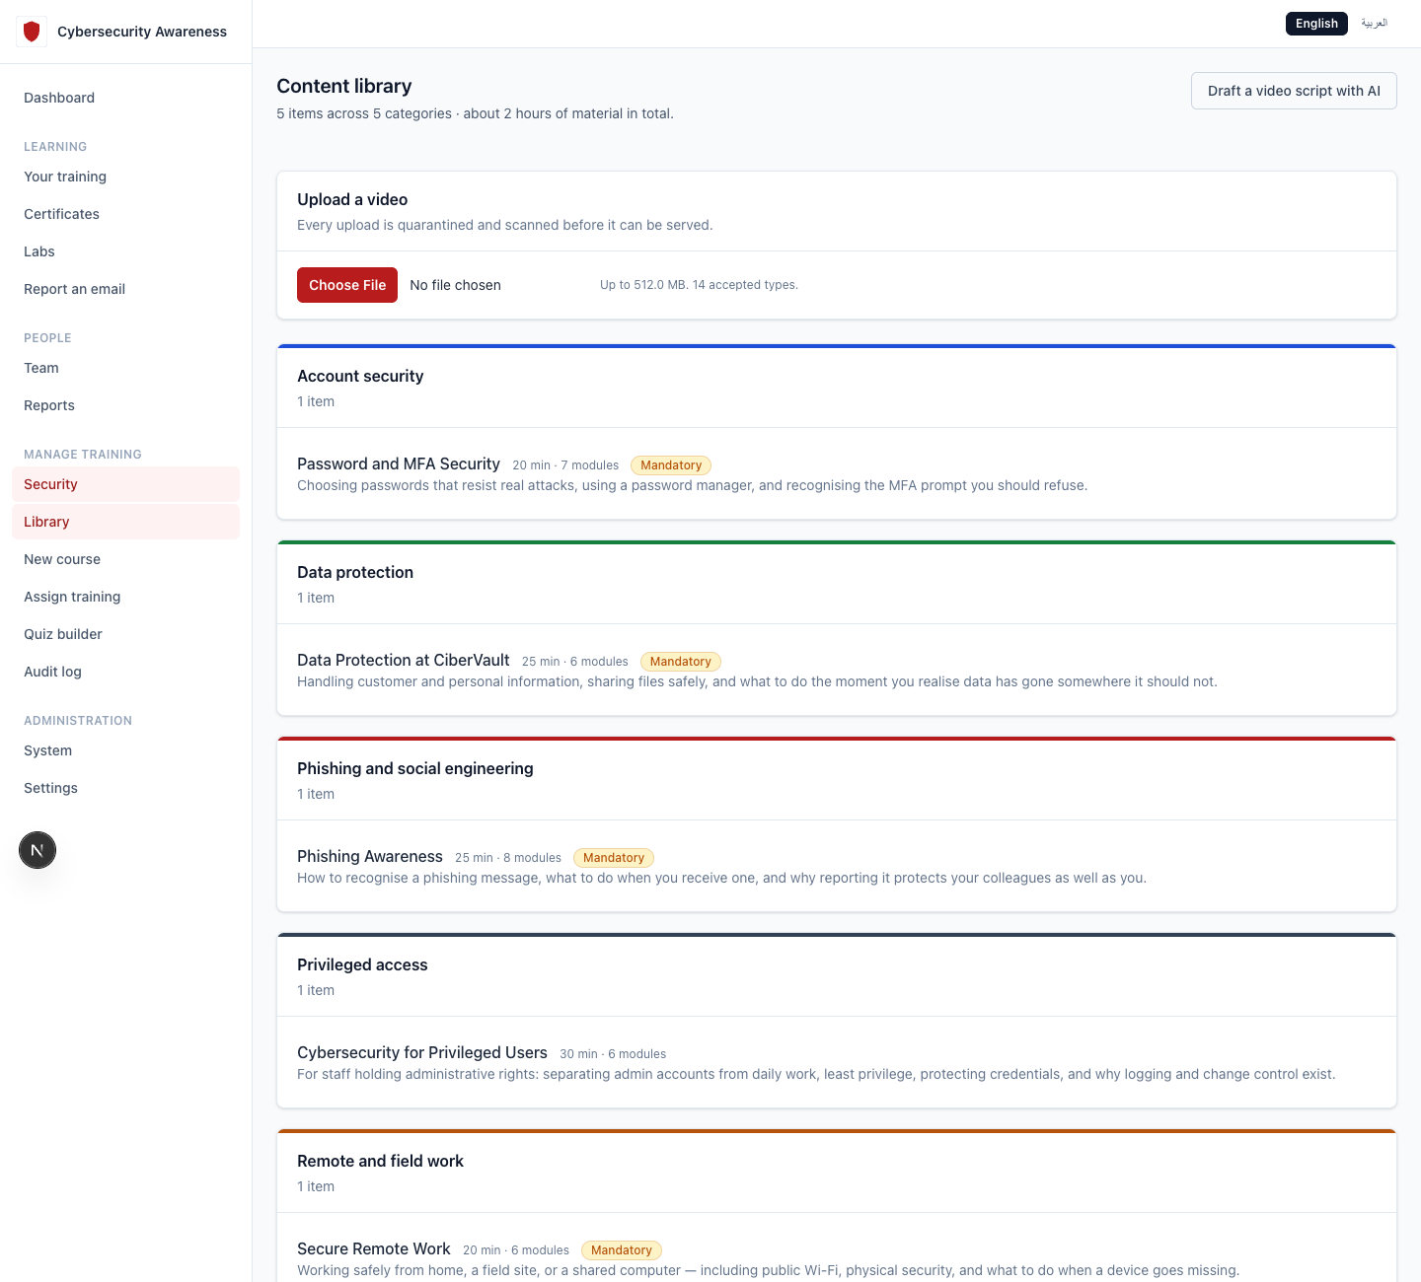
FASTER CONTENT
AI-Assisted Content Creation
Draft quizzes in seconds Describe a topic; get a reviewable set of questions back.
Video scripts, narrated Turn an approved script into a slide video with AI narration.
A person always decides Nothing an AI drafts is published without an author's review.
CiberVault
10

Slide 11
TRUST & SECURITY
Security You Can Trust
Role-based access control
Every permission is scoped and checked on every request — least privilege by default.
Tamper-evident audit log
Every administrative action is recorded in an append-only, hash-chained log.
Encryption at rest
Uploaded files and stored secrets are encrypted; scanned for malware before they're ever served.
Multi-factor authentication
Enforced for administrative access, with a fully audited emergency-access path.
Your deployment, your data
Self-hosted or dedicated hosting — your employee data does not leave your control.
CiberVault
11

Slide 12
ROADMAP
What's Next
Hands-on labs
Safe, isolated practice environments where IT and security staff build real skills — separate from mandatory awareness training.
Phishing simulations
Realistic, controlled campaigns to measure and improve real-world response, not just quiz scores.
Human risk scoring
A per-employee risk signal built from real behavior, to focus attention where it matters most.
CiberVault
12

